Slide 1
Minor Project
Crime Rate Data Prediction System
By : Shivali Panchal
Isha ghorpade
Harsh D Patel

Slide 2
ABSTRACT
Crime prediction is a process that finds out crime rate change in percentage form from one period to another period.
By using the concept of data mining , we can extract previously unknown useful information from an unstructured data.
With the increasing advent of computerised systems, crime data analysts can help the Law enforcement officers to speed up the process of solving crimes.
Even though we cannot predict who all may be the victims of crime but can predict the place that has probability for its occurrence.
This system can also br used for any crime departments for reducing the crime and solving the crimes with less time.

Slide 3
INTRODUCTION
Criminology is a study of crime, interdisplinary science that investigates and investigates crime and criminal performance data.
Criminal activity is now high and the police department is responsible for controlling and reducing criminal activity.
There has been tremendous increase in machine learning algorithms that have made crime prediction feasible based on past data.
The aim of this project is to perform analysis and prediction of crimes in states. It focuses on creating a model that can help to detect the number of crimes by its type in a particular state.
Various virtualization techniques and plots are used which will indirectly help to reduce the rates of crimes and can help to improve securities in such required areas.

Slide 4
OBJECTIVES
Aim of the project:
The aim of this project is to analyze and predict the crime rate that helps the investigator or police to solve the crime problems from the huge amount of information that is stored in database.
Data virtualization is also used to represent the output in the forms of images and chart.
Scope of the project:
The scope of the project is to prevent crimes or control the crime activities which may occur in the future.

Slide 5
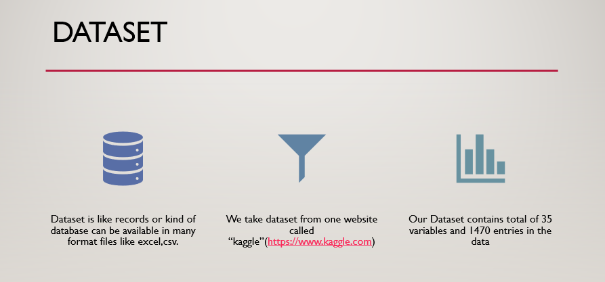
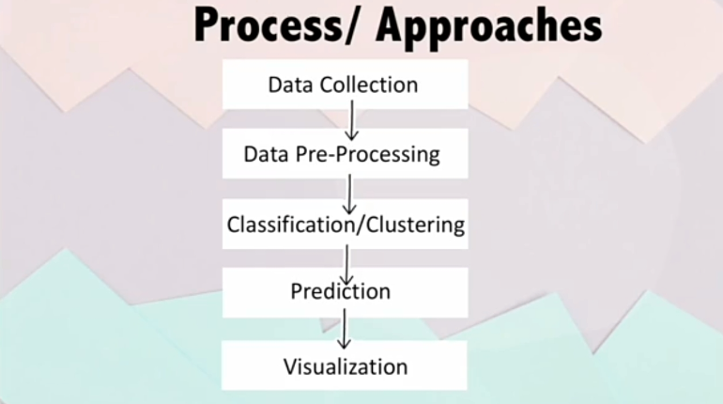
Why crime can be predictable?
According to statistical analysis, previous criminals tend to commit crimes again if they have committed successfully in the past, most probably they will choose back the same time and location.
Predicting crime may not provide 100% accuracy of result, but it will provide security to crime sensitive area.

Slide 6
Analysis
In our project we used different libraries of python for analysis Like :-
Pandas serves as one of the pillar libraries of any data science workflow as it allows you to perform processing, wrangling and munging of data.
Matplotlib for different type of chart’s Matplotlib provides various method to Visualize data in more effective way. Matplotlib allows to quickly make line graphs, pie charts, histograms, and other professional grade figures. Using Matplotlib, one can customize every aspect of a figure.
Seaborn for heatmaps

Slide 7
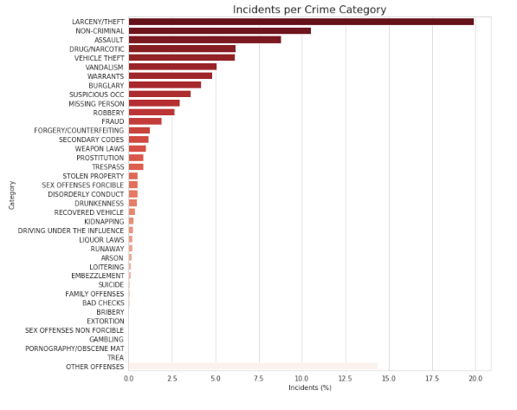
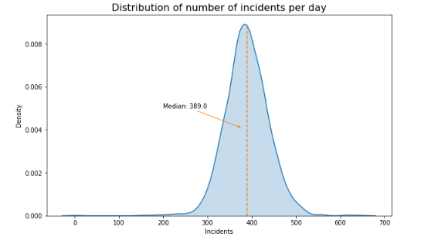
Visualizing the data

Slide 8
DESIGN AND METHODOLOGIES
Data collection
Data collection is one of the most important tasks in building a machine learning model. We collect the specific dataset based on requirements from internet. The dataset contains some unwanted data also. So we first need to pre-process the data and obtain perfect data set for algorithm.
Pre-processing
It is the gathering of task related information based on some targeted variables to analyse and produce some valuable outcome. It is must to process the data before analysing it and coming to the results. Data pre-processing can be done by data cleaning, data transformation, data selection.

Slide 9
Data mining techniques
Data collection is one of the most important tasks in building a machine learning model. We collect the specific dataset based on requirements from internet. The dataset contains some unwanted data also. So we first need to pre-process the data and obtain perfect data set for algorithm.
Data Virtualization
After implementing all scikit learn models. We will use matplotlib library to some data virtualization and analysis of crime which are requested in graphs and piecharts.

Slide 10
Who will be benefitted?
It can help us to analyze and perform comparative study in crime rate and infer various useful conclusions.
The prediction model will help to get a better idea to possible crime rate in near future.
By spotting the crime prone areas the general public can be given an alert about the crimes in different parts of a country.
It can help the concerned authorities to analyze and predict crime rate in order to ensure proper surveillance.
The data set developed by us over a period of time through web scraping can be further used for research

Slide 11
CONCLUSION
In this system, we get to classify and cluster to improve the accuracy of location and pattern crimes.
From the clustered results it is easy to identify crime prone areas and can be used to design precaution methods for future.
The classification of data is mainly used to distinguish type4s of preventive measures to be used for each crime.
Different crimes require different treatment and it can be achieved easily using this application.

